Slide 1
Compiler Design
Left Recursion and Left Factoring

Slide 2

Left Recursion: Infinite Looping problem
A grammar is left-recursive if it has a non-terminal A, such that there is a derivation :
A ⇒ Aα, for some α.
+
Top-Down parsing can’t reconcile this type of grammar, since it could consistently make choice which wouldn’t allow termination.
A ⇒ Aα ⇒ Aαα ⇒ Aααα … etc. A→ Aα | β
So we have to convert our left-recursive grammar into an equivalent grammar which is not left-recursive.

Slide 3
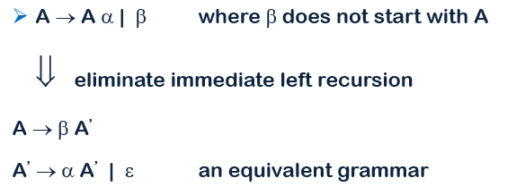

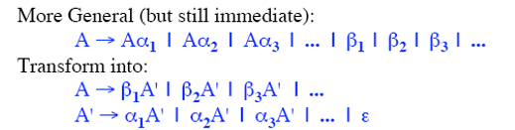
Immediate Left Recursion

Slide 4
Immediate Left Recursion Elimination: example
Our Example :
E → E + T | T
T → T * F | F
F → ( E ) | id
E → TE’ E’ → + TE’ | ∈
T → FT’ T’ → * FT’ | ∈
F → ( E ) | id

Slide 5
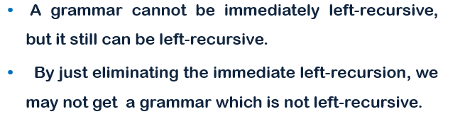
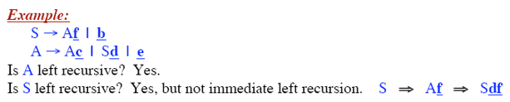
Left Recursion in More Than One Step

Slide 6
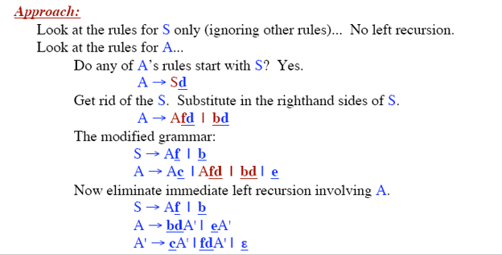
Left Recursion in More Than One Step: Elimination

Slide 7
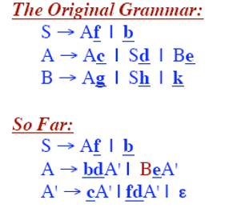
Left Recursion in More Than One Step: Elimination

Slide 8
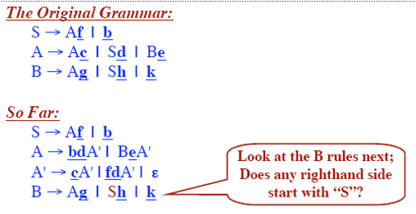
Left Recursion in More Than One Step: Elimination

Slide 9
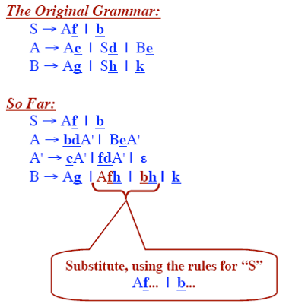
Left Recursion in More Than One Step: Elimination

Slide 10
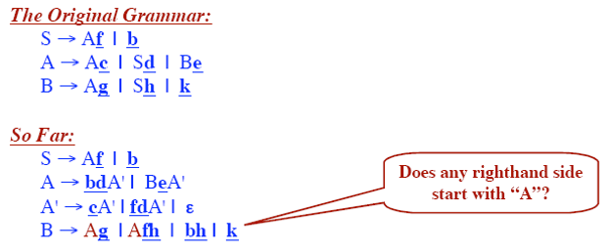
Left Recursion in More Than One Step: Elimination

Slide 11
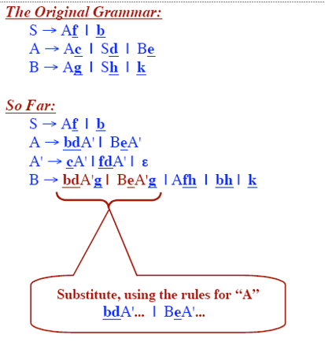
Left Recursion in More Than One Step: Elimination

Slide 12
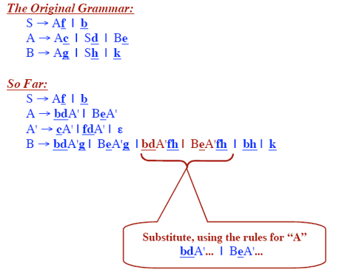
Left Recursion in More Than One Step: Elimination

Slide 13
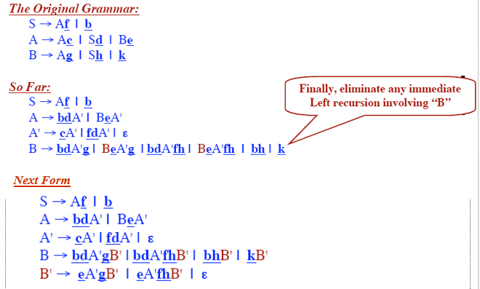
Left Recursion in More Than One Step: Elimination

Slide 14
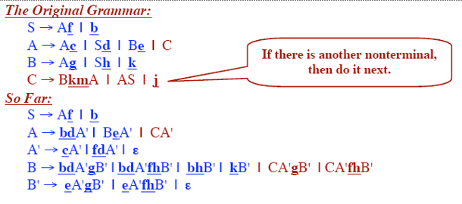
Left Recursion in More Than One Step: Elimination

Slide 15
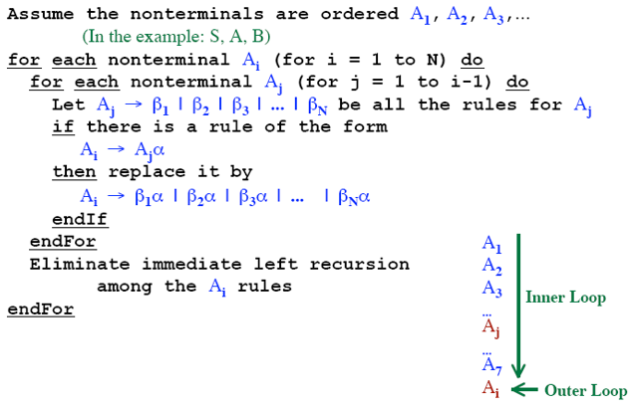
Algorithm for Eliminating Left Recursion

Slide 16
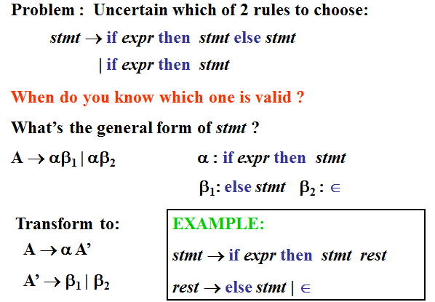
Left Factoring: Common Prefix Problem

Slide 17
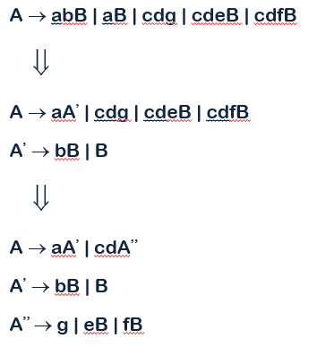
Left Factoring : Example

Slide 18
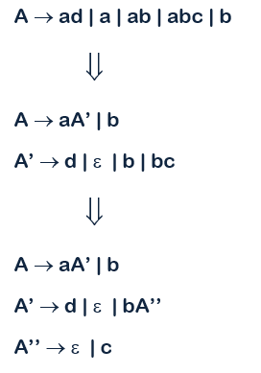
Left Factoring : Example

Slide 19
The End

